Slide 1

Operating System (CSC 3150) Tutorial 4
Lele Li: 221019053@link.cuhk.edu.cn

Slide 2
Attention
The arrangement of tutorials on Wednesday will be adjusted to Tuesday in this week. One tutorial session will be recorded.
Tutorials of CSC3150 of only this week are shown below.
Tuesday (Date 2024-10-8): 19:00-19:50 and 20:00 - 20:50 (Tutorial on Zoom, TA Lele Li)
Thursday (Date 2024-10-10): 19:00-19:50 and 20:00 - 20:50 (Tut on Zoom, TA Lele Li)
ZOOM ID: 539 117 8318 (no password)

Slide 3
Target
In this tutorial, we will practice Pthread programming using c/c++.
Process
Thread
Pthread creation
Pthread termination
Pthread join
Pthread mutex
Pthread conditional value
Assignment 2

Slide 4
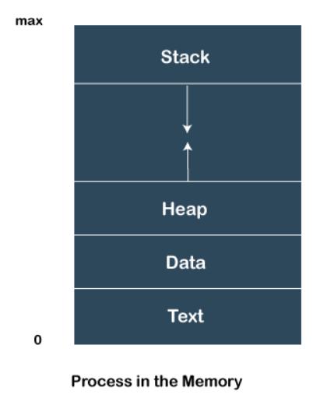
What is Process?
A process is an instance of a program that is being executed.
Features of Process
Each time we create a process, we need to make a separate system call for each process to the OS. The fork() function creates the process.
Each process exists within its own address or memory space.
Each process is independent and treated as an isolated process by the OS.
Processes need IPC (Inter-process Communication) in order to communicate with each other.

Slide 5
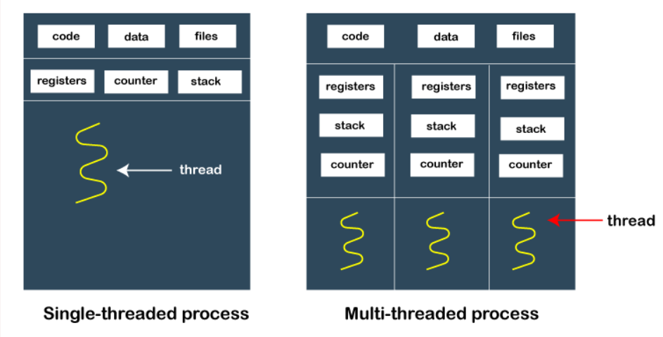
What is a thread? A thread is a single sequence stream within a process. Because threads have some of the properties of processes, they are sometimes called lightweight processes.
Threads are not independent from each other unlike processes. As a result, threads shares with other threads their code section, data section and OS resources like open files and signals. But, like processes, a thread has its own program counter (PC), a register set, and a stack space.
Threads use and exist within these process resources. They are able to be scheduled by the operating system and run as independent entities within a process.
A process can have multiple threads, all of which share the resources within a process and all of which execute within the same address space.

Slide 6
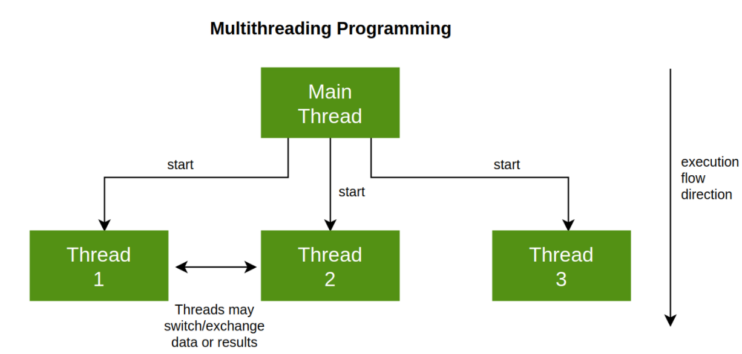
Why Multithreading?
Threads are popular way to improve application through parallelism. For example, in a browser, multiple tabs can be different threads.
Threads operate faster than processes due to following reasons:
1) Thread creation is much faster.
2) Context switching between threads is much faster.
3) Threads can be terminated easily
4) Communication between threads is faster.

Slide 7
Can we write multithreading programs in C? Unlike Java, multithreading is not supported by the C language standard. POSIX Threads (or Pthreads) is a POSIX standard for threads. Implementation of pthread is available with gcc compiler.
To the software developer, the concept of a "procedure" that runs independently from its main program may best describe a thread.
Pthread: POSIX Thread, a standard-based thread API for C.
other options: openMP, std::thread
When compiling Pthread in gcc/g++, should add option “-lpthread”.
Compile: gcc test.c –lpthread or g++ test.cpp -lpthread
Execution: ./a.out

Slide 8
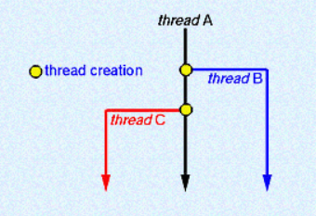
Pthread creation
pthread_create:
int pthread_create( pthread_t *thread,
const pthread_attr_t *attr,
void *(*start_routine) (void *),
void *arg);
thread: pointer to an unsigned integer value that returns the thread id of the thread created.
The attr parameter is used to set thread attributes. You can specify a thread attributes object
like scheduling policy, detached state, etc. Set NULL by default.
The start_routine is the C function that the thread will execute once it is created.
arg: pointer to void that contains the arguments to the function

Slide 9
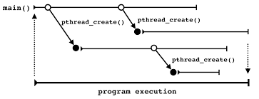
Pthread creation
Return value
On success, pthread_create() returns 0;
On error, it returns an error number, and the contents of *thread are undefined.
Pthread is declared with type:
pthread_t (defined in “sys/types.h”)

Slide 10
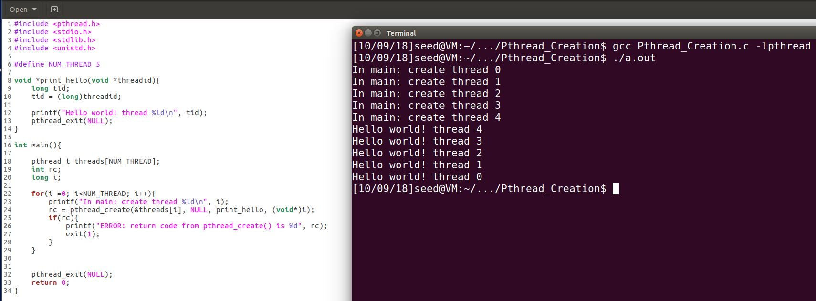
Pthread creation
The execution order of created threads depends on the task scheduling of the operating system
It might seems like out of order

Slide 11
Pthread termination
pthread_exit:
void pthread_exit(void *retval);
Parameters: This method accepts a mandatory parameter retval which is the pointer to an integer that stores the return status of the thread terminated. This function is used to explicitly exit a thread. Typically, the pthread_exit() function is called after a thread has completed its work.
If main() finishes before the threads it has created, and exits with pthread_exit(), the other threads will continue to execute. Otherwise, they will be automatically terminated when main() finishes.
Recommendation: Use pthread_exit() to exit from all threads...especially main().
Notes:
. The scope of this variable must be global so that any thread waiting to join this thread may read the return status.

Slide 12
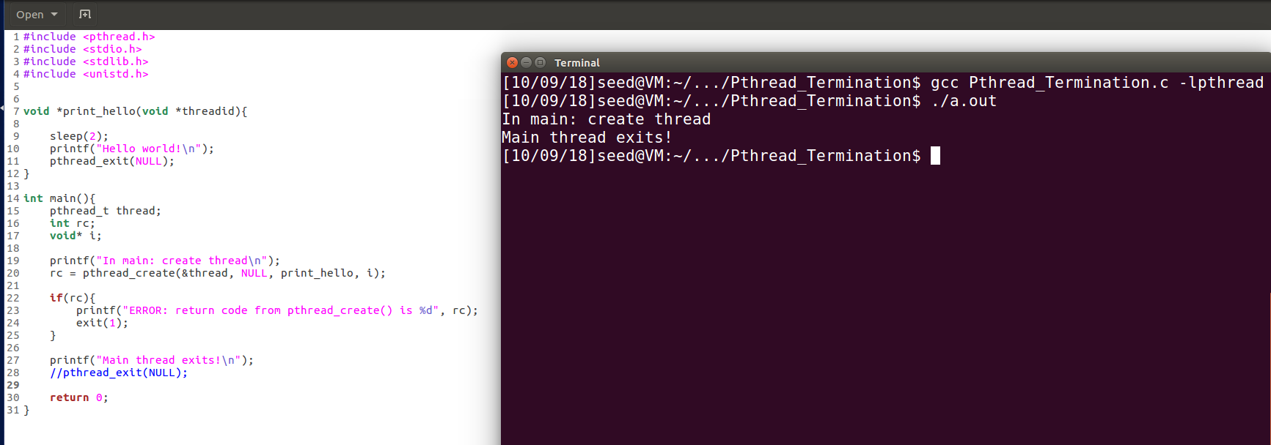
Pthread termination – main thread without pthread_exit()
Other threads would be automatically terminated when main() finishes. Therefore, they might not have finished their work.

Slide 13
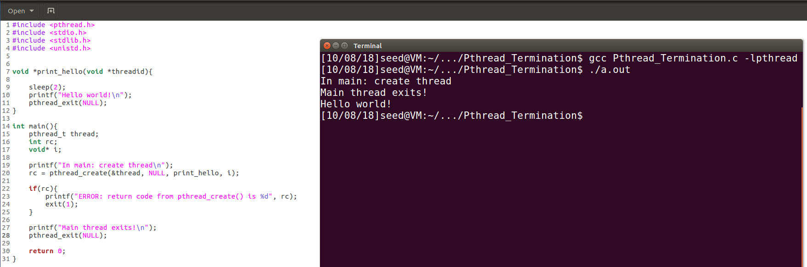
Pthread termination – main with pthread_exit(). The other threads will continue to execute.

Slide 14
Pthread join - synchronization
pthread_join:
int pthread_join(pthread_t thread, void *retval);
"Joining" is one way to accomplish synchronization between threads.
The pthread_join() function blocks the calling thread until the specified thread terminates.
The programmer is able to obtain the target thread's termination return status if specified through pthread_exit(), in the status parameter.

Slide 15
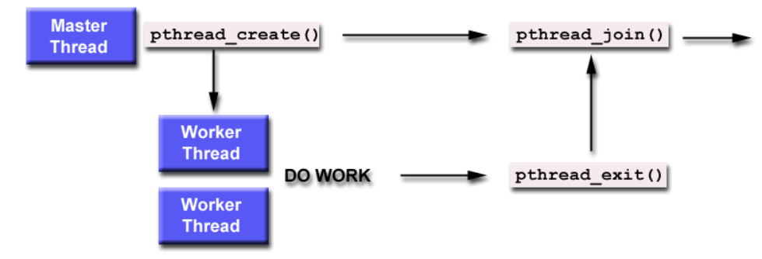
"Joining" is one way to accomplish synchronization between threads.

Slide 16
Pthread join - synchronization
Return value
On success, pthread_join() returns 0;
On error, it returns an error number.
It is impossible to join a detached thread.
When a thread is created, one of its attributes defines whether it is joinable or detached. Detached means it can never be joined. (PTHREAD_CREATE_DETACHED or PTHREAD_CREATE_JOINABLE)

Slide 17
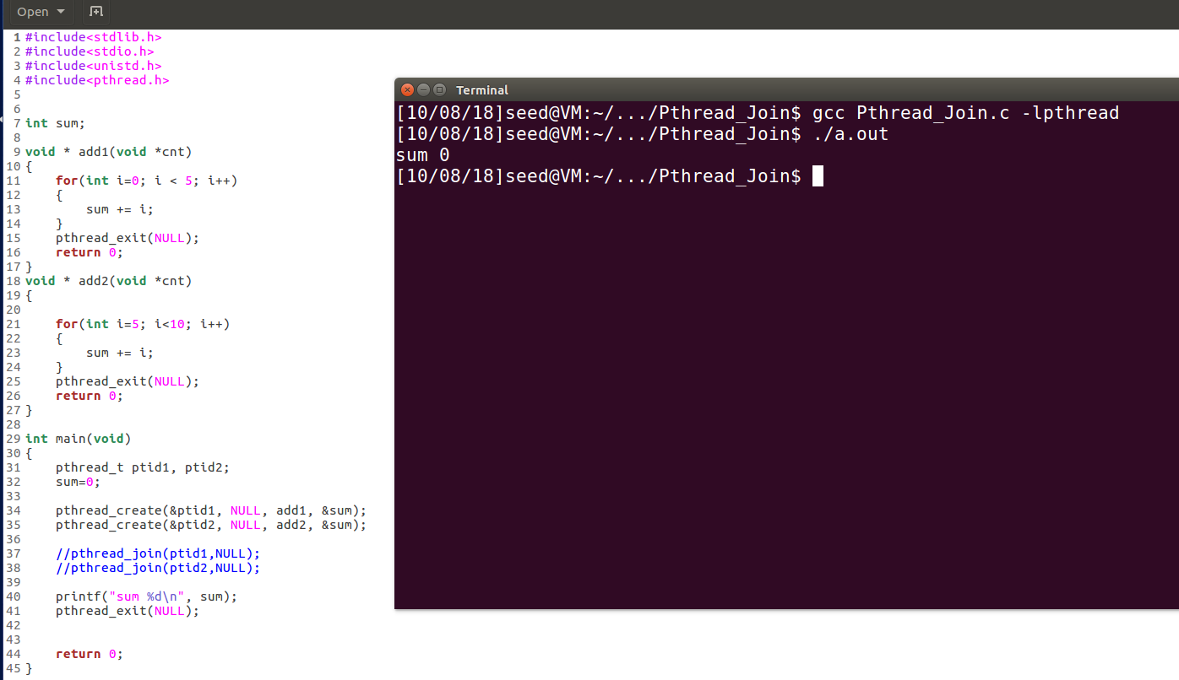
Pthread join – without calling pthread_join().

Slide 18
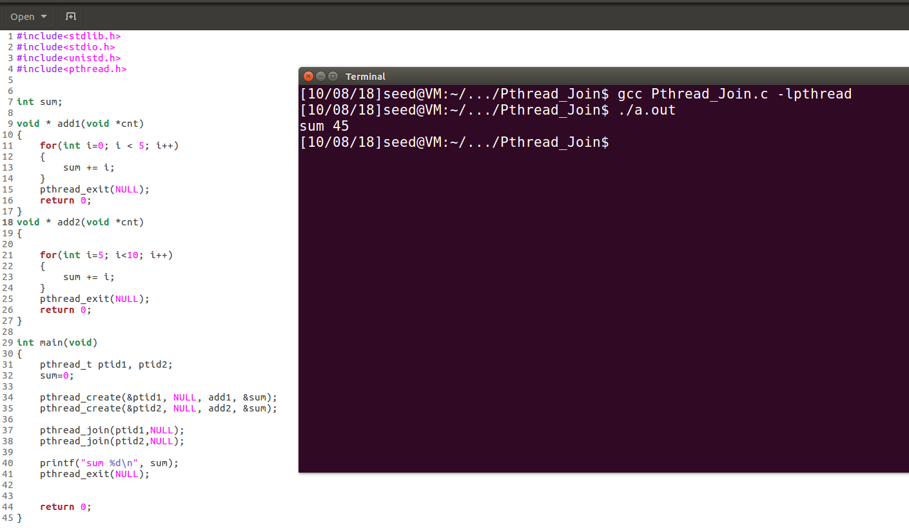
Pthread join – synchronization with calling pthread_join().
The main thread would stop and wait for ptid1 and ptid2 to finish at line 38.

Slide 19
Pthread mutex – flag for privacy/security
Mutex is an abbreviation for "mutual exclusion". Mutex variables are one of the primary means of implementing thread synchronization and for protecting shared data when multiple writes occur.
A mutex variable acts like a "lock" protecting access to a shared data resource.

Slide 20
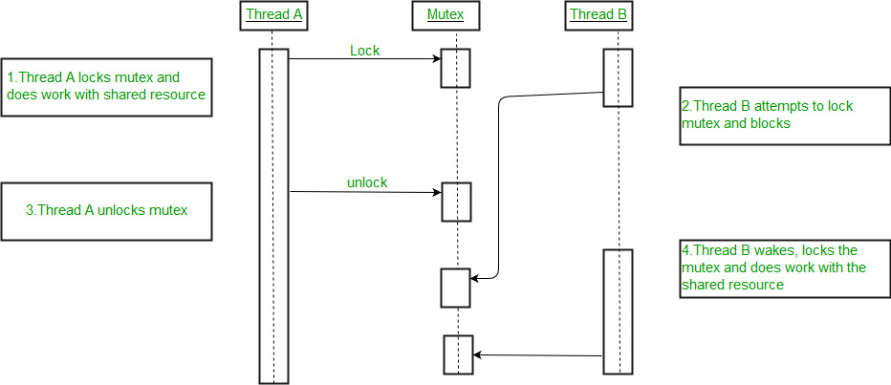
A mutex variable acts like a "lock" protecting access to a shared data resource.
Beginning, str=“”
(e.g, char* str)
str.append(“word”)
str=“world”
(e.g, char* str)
(e.g, char* str)
str.append(“hello”)
(e.g, char* str)
Finally, str=“world hello”

Slide 21
Mutex
A Mutex is a lock that we set before using a shared resource and release after using it.
When the lock is set, no other thread can access the locked region of code.
So we see that even if thread B is scheduled while thread A was not done accessing the shared resource. The code is locked by thread A using mutexes then thread B cannot even access that region of code.
So this ensures synchronized access of shared resources in the code.

Slide 22
Pthread mutex - flag
Mutex should be declared with type:
pthread_mutex_t (defined in “sys/types.h”)
Mutex should be initialized before it is used:
int pthread_mutex_init( pthread_mutex_t *mutex,
const pthread_mutexattr_t *attr);
It initialises the mutex referenced by mutex with attributes specified by attr.
If attr is NULL, the default mutex attributes are used; the effect is the same as passing the address of a default mutex attributes object.
Upon successful initialisation, the state of the mutex becomes initialised and unlocked.
Mutex should be free if it is no longer used:
int pthread_mutex_destroy(pthread_mutex_t *);

Slide 23
Pthread mutex - flag
Pthread mutex lock routines:
int pthread_mutex_lock(pthread_mutex_t *mutex);
int pthread_mutex_trylock(pthread_mutex_t *mutex);
int pthread_mutex_unlock(pthread_mutex_t *mutex);

Slide 24
Pthread mutex - flag
The pthread_mutex_lock() routine is used by a thread to acquire a lock on the specified mutex variable. If the mutex is already locked by another thread, this call will block the calling thread until the mutex is unlocked.
pthread_mutex_trylock() will attempt to lock a mutex. However, if the mutex is already locked, the routine will return immediately with a "busy" error code. This routine may be useful in preventing deadlock conditions, as in a priority-inversion situation.
pthread_mutex_unlock() will unlock a mutex if called by the owning thread. Calling this routine is required after a thread has completed its use of protected data if other threads are to acquire the mutex for their work with the protected data. An error will be returned if:
If the mutex was already unlocked
If the mutex is owned by another thread

Slide 25
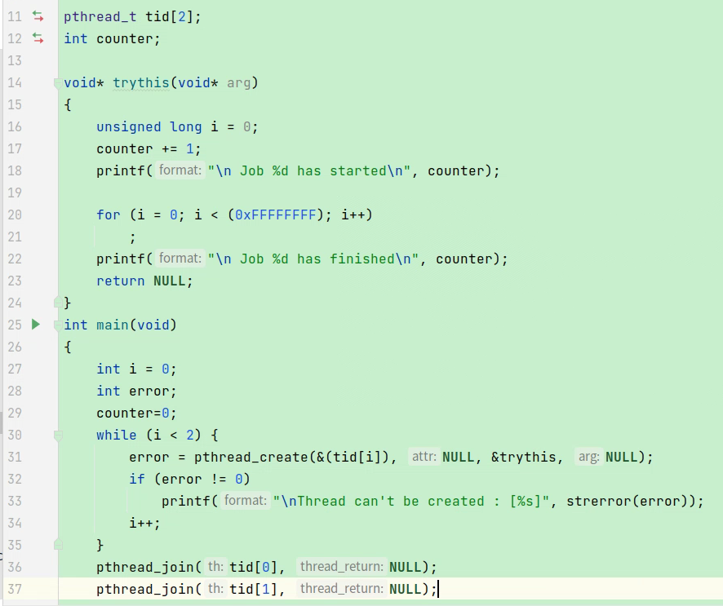
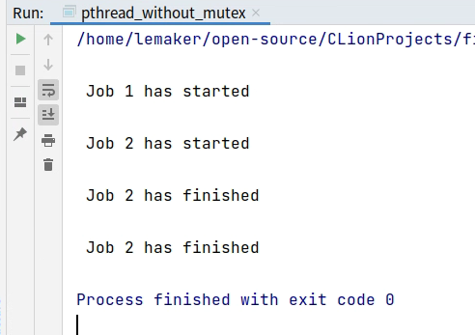
Suppose we have two jobs to update a shared variable called counter.
Line 20 consume more time (e.g. 3 seconds)
Execution Order: A B C D E F
Thread 1 (execute first)
Thread 2
A
Line 17: counter=1
C
Line 17: counter=2
B
Line 20: much time
D
Line 20: much time
E
Line 22: J“Job 2”
F
Line 22: J“Job 2”
It’s not what we want!

Slide 26
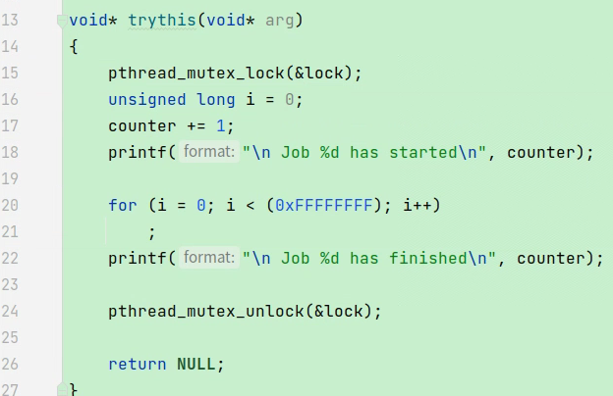
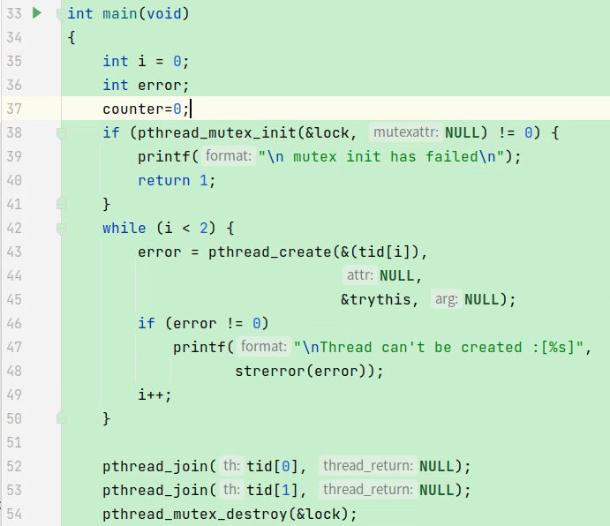
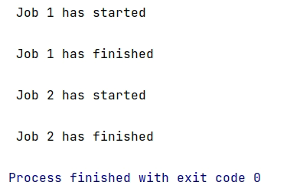
Line 20 consume more time (e.g. 3seconds)
Execution Order: A B C D E F (impossible)
Execution Order: A B E C D F or C D F A B E
Thread 1 (execute first)
Thread 2
A
Line 17: counter=1
C
Line 17: counter=2
B
Line 20: much time
D
Line 20: much time
E
Line 22: J“Job 1”
F
Line 22: J“Job 2”
It’s correct!
https://www.geeksforgeeks.org/mutex-lock-for-linux-thread-synchronization/

Slide 27
Pthread condition - signals
Condition variables provide yet another way for threads to synchronize.
While mutexs implement synchronization by controlling thread access to data, condition variables allow threads to synchronize based upon the actual value of data.
A condition variable is always used in conjunction with a mutex lock.

Slide 28
References
https://www.baeldung.com/cs/async-vs-multi-threading
https://www.javatpoint.com/process-vs-thread
https://www.geeksforgeeks.org/multithreading-c-2/
https://www.geeksforgeeks.org/condition-wait-signal-multi-threading/
http://www.cs.unibo.it/~ghini/didattica/sistop/pthreads_tutorial/POSIX_Threads_Programming.htm
https://www.geeksforgeeks.org/mutex-lock-for-linux-thread-synchronization/

Slide 29
Pthread condition - signals
Condition variables must be declared with type: pthread_cond_t
pthread_cond_t (defined in “sys/types.h”)
Condition variables must be initialized before it is used:
int pthread_cond_init(pthread_cond_t *, const pthread_condattr_t *);
Condition variables should be freed if it is no longer used:
int pthread_cond_destroy(pthread_cond_t *);

Slide 30
Pthread condition - signals
Pthread condition routines:
int pthread_cond_wait(pthread_cond_t *, pthread_mutex_t *);
int pthread_cond_signal(pthread_cond_t *);
int pthread_cond_broadcast(pthread_cond_t *);

Slide 31
Pthread condition - signals
pthread_cond_wait() blocks the calling thread until the specified condition is signalled. This routine should be called while mutex is locked, and it will automatically release the mutex while it waits.
The pthread_cond_signal() routine is used to signal (or wake up) another thread which is waiting on the condition variable. It should be called after mutex is locked, and must unlock mutex in order for pthread_cond_wait() routine to complete.
The pthread_cond_broadcast() routine should be used instead of pthread_cond_signal() if more than one thread is in a blocking wait state.
这里注意wait等到信号后会自动重新获取mttux锁

Slide 32
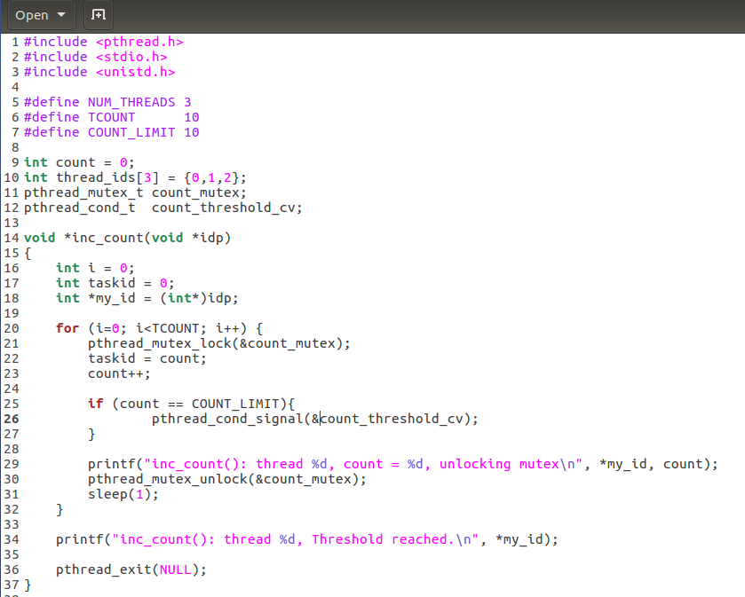
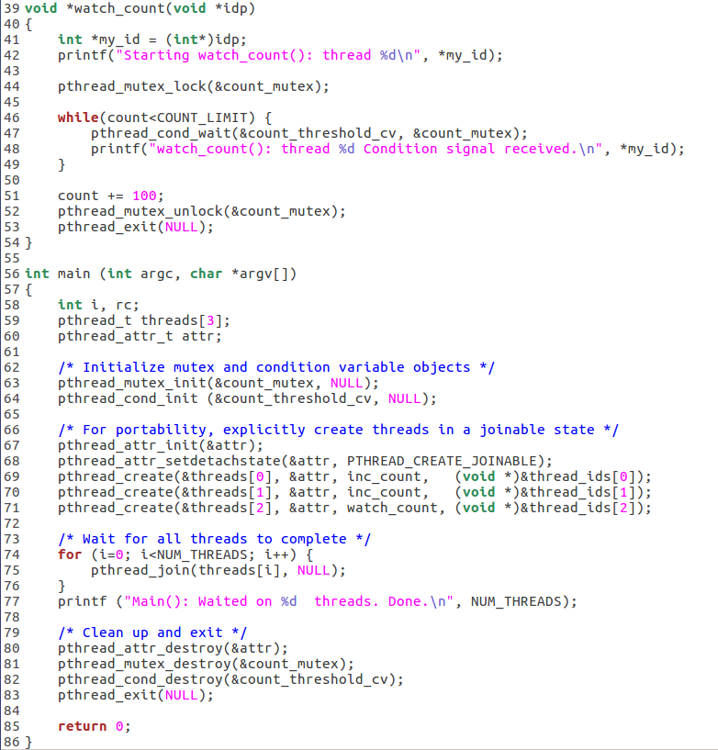
Pthread condition - signals
Release the mutex at line 47

Slide 33
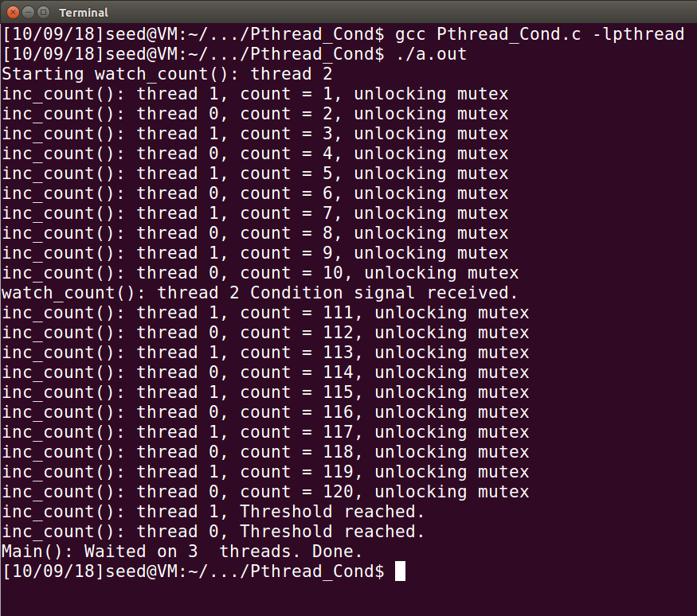
Pthread condition - signals

Slide 34
Thank you

